Slide 1

Housekeeping
Module 7 – Beginning the Relationship
Please mute yourself if you are not speaking.
Feel free to include your pronouns in your Zoom Name.
Use Zoom reaction tools, chat box, hands up, etc.
Be prepared to have video on at all times; as such, please be appropriately dressed and limit distractions.
Contribute to the conversations out loud and in the chat box.
If someone has already shared what you were going to say, lower your hand and put “agree” in the chat.
Notes:
COORDINATOR
Read out Housekeeping slide.

Slide 2
Expectations
Module 7 – Beginning the Relationship
Arrive on time.
Help us create a confidential, non-judgmental space (no screenshots or recordings).
Please keep your phones on silent.
Avoid cross-talk and side-talk.
Learn from each person’s perspective.
Language – please bring new language to us as we recognize that language is ever-changing.
Have fun!
From the group:
[ADD PARTICIPANT ADDITIONS, IF ANY]
Notes:
COORDINATOR
Read out Expectations slide.

Slide 3
Beginning the Relationship and Ethics
Module 7
Notes:
Trainer Manual
Module 07: Beginning the Relationship and Ethics © 2023 PeerWorks
This training program is designed to be accessible to all trainers, and ensure that all participants receive the same quality of education regardless of specific trainers’ background and experience.
This manual is a living document and should be understood as a set of guidelines, not as a fixed script. Feel free to adapt the language to your style of presentation. We also recognize that language is always changing; please update terminology when necessary. The synchronous sessions should be dynamic, engaging experiences.
TRAINER
Welcomes everyone and states the topic of today’s module.

Slide 4
Land Acknowledgement
Module 7 – Beginning the Relationship
I am speaking to you today from Toronto. Toronto is in the 'Dish With One Spoon Territory’. The Dish With One Spoon is a treaty between the Anishinaabe, Mississaugas and Haudenosaunee that bound them to share the territory and protect the land. Subsequent Indigenous Nations and peoples, Europeans and all newcomers have been invited into this treaty in the spirit of peace, friendship and respect.
The "Dish", or sometimes it is called the "Bowl", represents what is now southern Ontario, from the Great Lakes to Quebec and from Lake Simcoe into the United States. *We all eat out of the Dish, all of us that share this territory, with only one spoon. That means we have to share the responsibility of ensuring the dish is never empty, which includes taking care of the land and the creatures we share it with. Importantly, there are no knives at the table, representing that we must keep the peace.
We want to acknowledge and respect all Indigenous people who don’t live in their traditional territories but have made a home in different parts of Ontario and have brought their culture with them.
Notes:
COORDINATOR
Read out PeerWorks’ land acknowledgement.

Slide 5
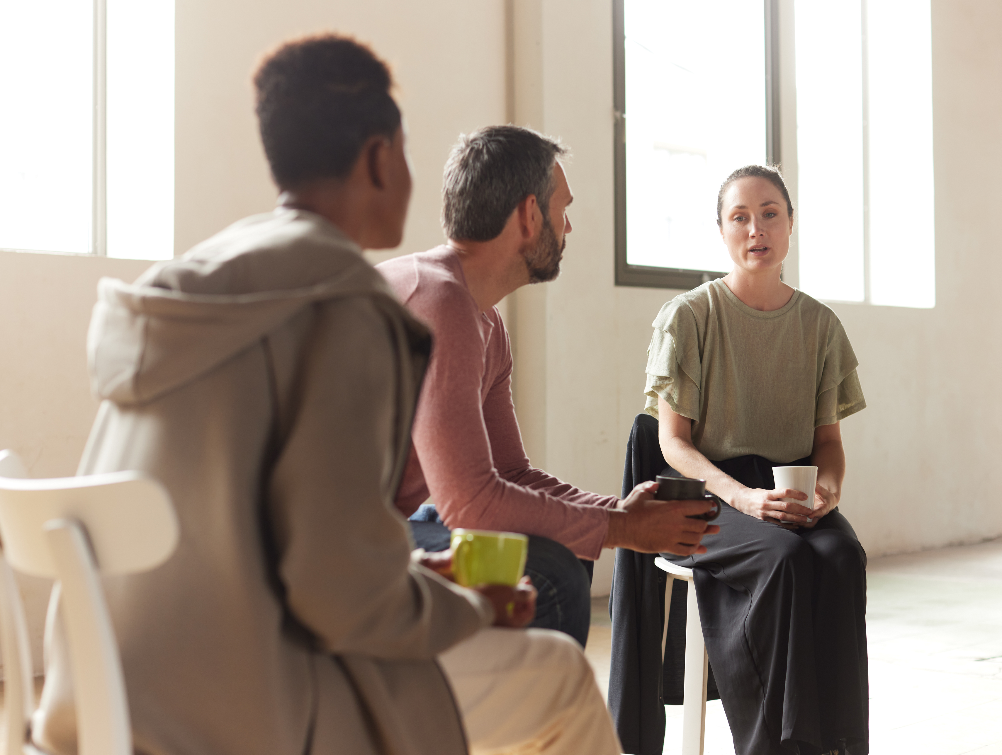
Icebreaker Activity
Module 7 – Beginning the Relationship
What is your name?
What is the last thing you did for yourself?
Notes:
TRAINER
“What is the last thing you did for yourself?”
As the trainers, feel free to go first. Keep it brief and thank people for sharing. People often associate meals with the culture and community. This question is a way to have us reflect on the self-care we are implementing in our everyday life.

Slide 6
Module Overview
Module 7 – Beginning the Relationship
In Module 7 we will be discussing Beginning the Peer Support relationship, which will include professionalism and Ethics.
In order to create a supportive, mutually-beneficial Peer Support relationship, the Peer Supporter/Peer must first establish a clear foundation. It is easier to set ethical guidelines and standards at the beginning of the relationship, then try to integrate them after the relationship has developed. These guidelines should be aligned with professional Peer Support standards, as well as your organization’s expectations.
Notes:
TRAINER
Read the Module Overview and Learning Objectives out loud or invite a participant to read it out loud.

Slide 7
Learning Objectives
Module 7 – Beginning the Relationship
Through the successful completion of Module 7, you will be able to:
State the significance of professionalism within the Peer Support relationship.
Understand how ethics can be implemented in a Peer Support relationship.
Practice an ethical approach to Peer Support.
Notes:
TRAINER
Read the Module Overview and Learning Objectives out loud or invite a participant to read it out loud.

Slide 8
Peer Support Canada Code of Conduct
Module 7 – Beginning the Relationship
I will act ethically, according to the values and principles of peer support.
I will treat all people with respect and dignity.
I will respect human diversity and will foster non-discriminatory activities.
I will honour the rights, beliefs and personal values of individuals.
I will behave with honesty and integrity in providing support to peers.
I will respect the privacy of individuals and maintain confidentiality within the limitations of program policies and the law e.g. potential harm to self or others.
I will not knowingly expose a peer to harm.
I will not take advantage of the peer relationship for personal benefit, material or financial gain.
I will respect the boundaries of peer support work and will not engage in romantic or sexual relationships with the peers that I support.
I will not provide peer support in a manner that negatively affects the public’s confidence in peer support.
Notes:
TRAINER
Here is Peer Support Canada’s Code of Conduct. Let the participants know that they will be signing it at the end of the training program.
Go around the group and have each person (or as many as you get through) read out of one of the lines.

Slide 9
Confidentiality as a Peer Supporter
Module 7 – Beginning the Relationship
When sharing with other Peer Supporters, we will not disclose any specific information about our Peers or their experiences. Instead, we will only share the information necessary to gain support and/or consult with others.
Be aware of any potential violations and address these issues when you have concerns.
Remember that while we hold confidentiality as Peer Supporters, our Peer is not held to the same guidelines. Don’t share something if you are worried about others finding out about it.
Consider these guidelines in tandem with your organization’s guidelines on confidentiality.
Notes:
TRAINER
The next slide contains some guidelines for Confidentiality as a Peer Supporter. Read through the guidelines.
Notes you may consider adding:
In this training session we can practice confidentiality in this same way in order to prepare ourselves for our work as Peer Supporters.
Think back to our expectation: “help us create a confidential and non-judgmental space.”
Discussion question: What does confidentiality encompass?
Note: even sharing that someone is seeing a Peer Supporter is a breech of confidentiality.

Slide 10
Breaking Confidentiality
Module 7 – Beginning the Relationship
We are required to break confidentiality when we believe that someone is going to harm themselves or harm others.
How do you know when it reaches the point of breaking confidentiality vs just a conversation (e.g. regarding suicidal ideations)?
Identify what your concern is and discuss it with your peer. Are they actively making plans? A passing comment is not necessarily a reason to call 911.
If they are making plans, you must report it and you can ask them how they would like you to report it. This can have an impact on the outcome. Support them through the process. Help create scenarios where they retain agency even when you must report them.
Notes:
TRAINER
Next we will be discussing situations in which we are required to break confidentiality. There aren’t very many situations in which this is required.
Read through the slide and feel free to expand on any of the points by discussing your own experience breaking confidentiality, if you have had such an experience. You can also ask the group if they have had an experience that they have learnt from that they would like to share. Of course, as per confidentiality, we will refrain from discussing names/specifics that would identify our Peers.
We will expand on this discussion in later modules on Being Informed and Crises, and recommend complementary trainings, such as Assist.

Slide 11
Workplace Confidentiality
Module 7 – Beginning the Relationship
What rules/guidelines does your workplace have about confidentiality?
What rules/guidelines does your workplace have about documentation?
Is there a discrepancy between the two? How do you navigate this?
Notes:
TRAINER
Workplace Confidentiality Group Discussion: read out the questions one by one and encourage discussion from the group.
Things that might come up:
Historically peer support does not document. Ongoing pressure to document from risk-averse organizations and organizations that use electronic health records.
You can co-write documentation with your Peer in order to honour the values of Peer Support. You can ask: “What would you like me to report about this meeting? It is a requirement that I need to say something about this meeting. What pieces would make you feel comfortable?”
You can document without breaking confidentiality, such as “We discussed resources/employment opportunities” or “We discussed personal lived experiences.”
Reiterate that confidentiality is paramount in peer support.

Slide 12
Professionalism
Module 7 – Beginning the Relationship
Appearance – Be clean and fully dressed. Wear clothing that doesn’t have potentially offensive imagery/words.
Attitude: Be respectful and maintain a positive attitude. Be courteous and greet your Peer. Refrain from potentially offensive jokes or comments.
Competence: Bring the knowledge and skills you’ve developed in Peer Support training. Be honest when you don’t know something and offer to research it further.
Accountability: Arrive on time and live up to your commitments. Be honest and genuine. Obstacles may arise, but being accountable means offering alternative solutions and acknowledging your own limitations.
Notes:
TRAINER
Introduce the slide about professionalism. Acknowledge that these are general guidelines and that different organizations might have different specific rules.
Read through each of the points, or ask someone to read them out with you.
Things that might come up:
If you’re working in harm reduction/substance use, you might be asked not to wear clothing with references to substances.
You might be asked to try and match the peers and avoid showy jewelry or outfits that might create the appearance of a power imbalance.
Peer Support can be found everywhere, include inside other larger organizations that might have their own professional guidelines. “Professionalism also means acknowledging that you and your Peer have clearly defined roles. While you may be friendly and share common interests, you are the Peer Supporter, and they are the Peer. You are there to offer support and provide a service. This builds on what we discussed in Module 5: Boundaries.”
At this point you should be hallway though the allotted time.

Slide 13
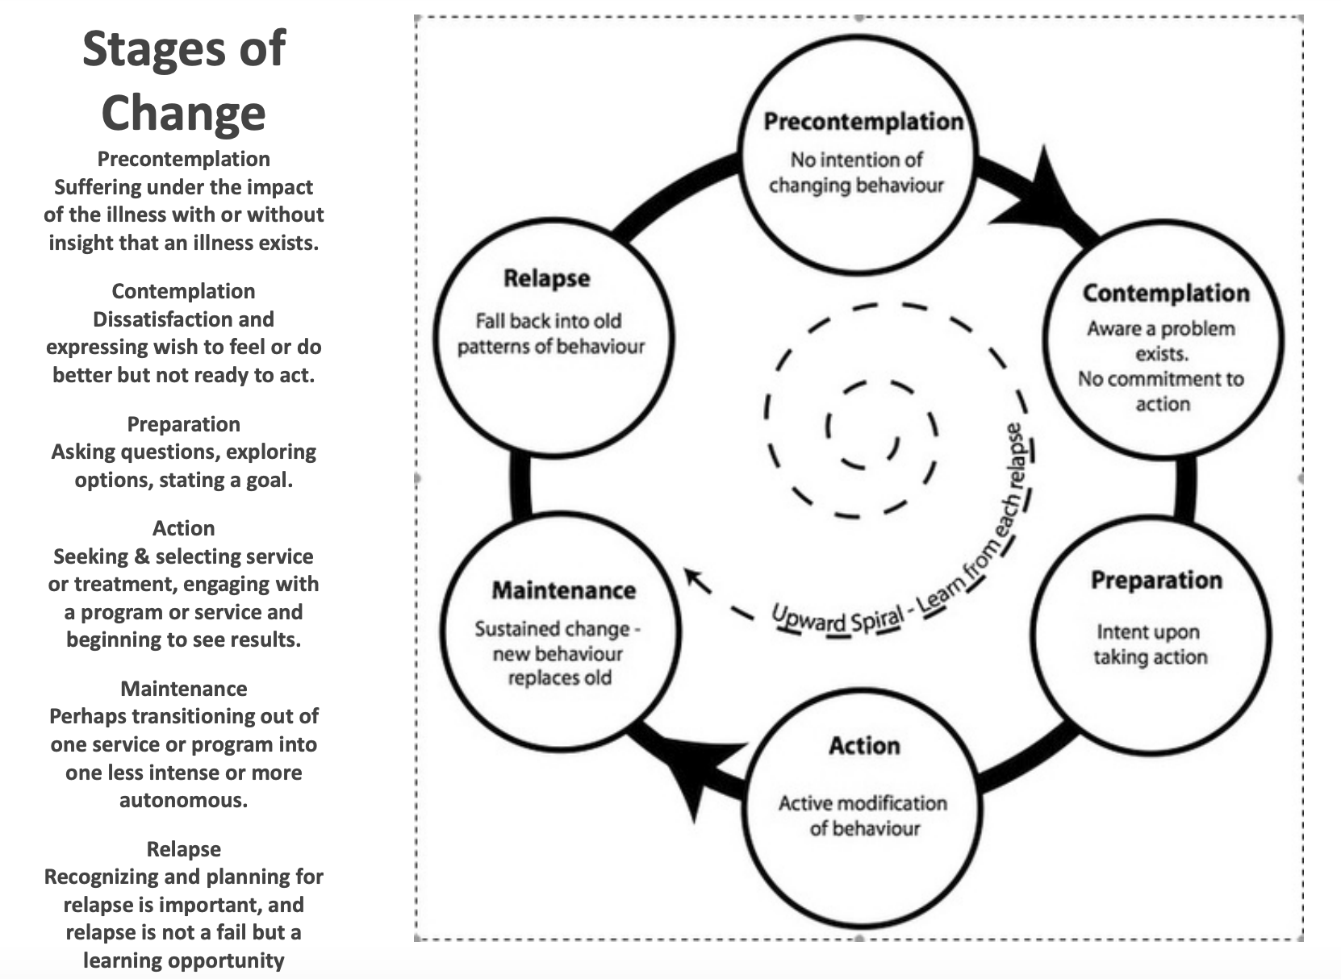
Notes:
TRAINER
Describe the 6 stages of change as outlined on the slide.

Slide 14
BREAKOUT ROOM ACTIVITY
Join two other people in the training session. Decide who will share first (Peer Supporter), who will listen attentively and respond (Peer) to the person sharing, and who will support and observe (Observer). Once you have completed one round, the Observer will guide the feedback loop.
After the feedback the person in the role of the Peer writes down an area of strength as well as an area of growth in relation to the role of Peer Supporter during the exercise. Rotate twice more so that every person in the triad has an opportunity to experience each role.
This activity should take 10-15 minutes.
Peer (listens attentively and responds)
Observer (supports and observes)
Peer Supporter (shares)
Notes:
COORDINATOR
Explanation of a feedback loop:
“A feedback loop gives you an opportunity to review and reflect on the skills practice experience.
As such, during the feedback loop, the person who is in the role of the Peer Supporter always goes first. The Peer Supporter begins by sharing their overall impressions of the experience, followed by identifying their greatest strength as well as a suggesting an area for their further growth.
As they are reflecting on their experience, the Peer and the Observer listen attentively. Then the Peer comments. They too describe their experience of the exercise overall, followed by identifying the Peer Supporter’s greatest strength as well as suggesting an area for further growth.
The Observer adds any additive comments, and can act as the timekeeper. At the conclusion of the feedback loop, the Peer Supporter records an area of strength as well as an area of growth in relation to the role of Peer Supporter. Rotate twice more so that every person in the triad has an opportunity to experience each role.”
“As this is our first exercise using the feedback loop and your first time practicing the role of Peer Supporter (at least in this training program), we want to hear your first impressions. How did it feel to inhabit that role? What came naturally? What do you feel you need to work on?”
After the exercise is completed, invite everyone to discuss the experience as a whole. Ask if everyone feels like their voice has been heard and if not, invite them to share.
Group Activity Instructions: During these group discussions you may hide the PowerPoint so that you can see the faces of the participants. Ask people to share their experience introducing themselves.
Questions you can ask:
How did you decide what to share?
What did you learn from your group members’ introductions?

Slide 15
Activity: Introducing
Yourself
Module 7 – Beginning the Relationship
What does a Peer Supporter need to consider as they introduce themselves ( and Peer Support) to a Peer for the first time?
Individually: Take 5 minutes to craft an introduction that you would use to introduce yourself to a Peer.
In Groups of 3: Designate one person as the Peer, the second person as the Peer Supporter, and the third person as the Observer.
As the Peer Supporter, read your written introduction to your partner. As the Peer, let your partner know if there is anything else that you would want to know about them in this initial meeting. Then as the observer describe, how the interaction appeared from the outside. Repeat the activity twice more so that everyone has a chance to act on every role.
Notes:
COORDINATOR
Activity: Introducing Yourself (Skills Practice)
“There are many ways that a Peer might become acquainted with a Peer Supporter and the services that they offer. For example: referrals, walk-in, outreach, information resource, website, participation in activities, other programs/services. Once, our Peers take those first steps, it is important that we initiate a positive first interaction to create the foundation for a Peer Support relationship. As such, our main group activity this session will focus on introductions.”
Read out the instructions for the individual activity. After 5 minutes of individual work, break out the group into break-out rooms and have people practice introducing themselves.
Give the break-out approximately 10 – 15 minutes to get through the exercise three times. Ask the Observer to serve as timekeeper and ensure each round is limited to five minutes.

Slide 16
Guiding an Initial Meeting
Module 7 – Beginning the Relationship
The intention of an Initial Meeting is to establish the Peer/Peer Supporter relationship. After you have introduced yourself, it’s important to ensure that the Peer is fully informed about the service that you, as a Peer Supporter, are offering. Review the Peer’s understanding of the Peer Support service being offered as well as the general roles and responsibilities of both the Peer and the Peer Supporter.
After the initial meeting, the Peer Supporter invites the Peer to suggest their preferred next step.
Do they wish to participate in the Peer Support service?
Would they like to give further thought to whether or not they wish to participate in the service?
Do they decline the service?
Notes:
TRAINER
Read through the first paragraph of the slide and offer some examples of what might happen in this meeting.
Possible example you may use:
“For example, you may state how often you are able to meet, what these meetings usually entail, and discuss general boundaries (specific boundaries can be discussed when/if the Peer has agreed to continue on in a Peer Support relationship.)”
Ask the group what else they have discussed in an initial meeting, if they have worked as a Peer Supporter before.
Move on to the second half of the slide that starts with “At the conclusion of…”
After you have read the three possibilities, it is important to reiterate that these options are there to give the Peer agency, as one of the core values of Peer Support is self-determination.

Slide 17
Finding the Focus
Module 7 – Beginning the Relationship
Peers might have many reasons for wanting to engage in a Peer Support relationship, but in order to be productive, it’s important to find a main focus, or at least a main starting point.
Help your Peer determine what kind of support they need from you during your first sessions, and what they would like to focus on in future sessions.
What are some possible focuses for a Peer Support Relationship?
Notes:
TRAINER
Read the Module Overview and Learning Objectives out loud or invite a participant to read it out loud.
Points you might raise during the discussion:
Ensure that the focus is coming from the Peer and not the Peer Supporter.
Sometimes people are referred to Peer Support and told what they need to work on, but it isn’t something that they want to work on.
That focus can change over the course of their Peer Support. Especially if there is a considerable amount of time between Peer Support sessions.
You can always check in on your peer and ask if they have the same focus: “I haven’t seen you in x amount of time. Last time we talked about this, is that what you’d like to discuss or is there something more pressing today?”
Sometimes it is important to bring it back to the topic they wanted to focus on. You can even ask them if they would like you to check in on that topic periodically.

Slide 18
Ways to Support Your Peer
Module 7 – Beginning the Relationship
Instill confidence in your Peer by encouraging them to take a desired next step. You can do this through cheerleading, emphasizing the positive, and role modelling.
Help your Peer Develop Desired Skills related to their intentions, wishes and dreams. Skills are learned or enhanced through explanation (sharing information), demonstration (showing examples) and practice (creating rehearsal exercises).
Aid your Peer in Acquiring Supports: A support is something that assists a Peer in taking steps towards realizing their intentions, wishes and dreams. A support can be a person, place, activity or thing, such as: Consumer-Survivor Initiative, Internship Site, Skills Practices, Journal Reflections, Peer Support, Self-Care Routine, and Self Care Kit.
Notes:
TRAINER
“Regardless of what specific focus your Peer decides on, the following slide describe ways in which you can support your Peer. These supports can apply to almost all situations that you and your Peer may find yourselves in.”
Read through the slide and after you reach each description open the floor up to the group. Ask them if they can share any experiences they have had instilling confidence in a peer, helping their Peer develop skills, or helping their Peer acquire supports. It’s great to go over these concepts with the team, but sharing practical examples can bring life to theoretical ideas and help participants understand how they can do these things themselves.

Slide 19
Group Discussion Scenario
Module 7 – Beginning the Relationship
You notice that Bill has been hanging around the entrance of the Peer Support Service for the last few days. Upon approach, he avoids making eye contact but pulls a referral form from a local community mental health program from his pocket.
What do you do?
Notes:
TRAINER
Read through the scenario and open it up to discussion.
You may ask:
What would you do in this situation?
How does this relate back to what we’ve discussed about beginning a relationship?
Do you follow the focus provided by the reference?
What if the person doesn’t want to enter the building?

Slide 20
Resources
Module 7 – Beginning the Relationship
Peer Support Canada Code of Conduct
PeerWorks Webinar: Peer Support Documentation: Praxis or Peer Drift? By Calvin Prowse
Support House’s Documentation Guidelines
Notes:
COORDINATOR
Go through the resources from this session.

Slide 21

For Next Time:
Module 7 – Beginning the Relationship
No homework!
Enjoy your time off and take a well-deserved break.
Notes:
COORDINATOR
No homework for next time, as the group has had homework for every session so far. Thank the participants for their engagement and ask if there are any questions or comments.

Slide 22
Thank You
Notes:
TRAINER
Thank everyone for their time and ask if anyone has any final comments or questions that they want to bring forward.

